Slide 1
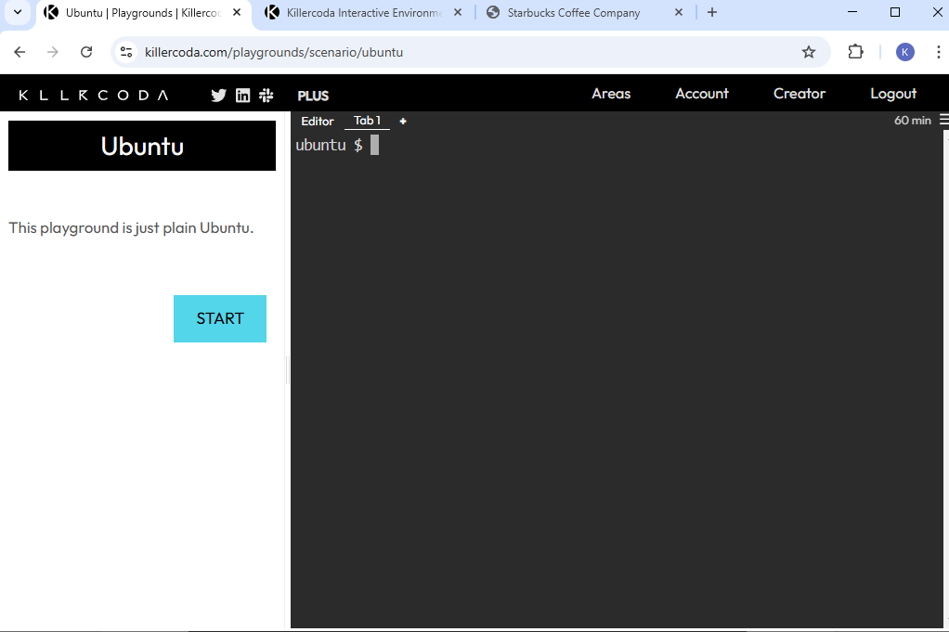
Access Killer Coda Ubuntu Playground and Initialize the Playground https://killercoda.com/playgrounds/scenario/ubuntu
DEVOPS INSIDER

Slide 2
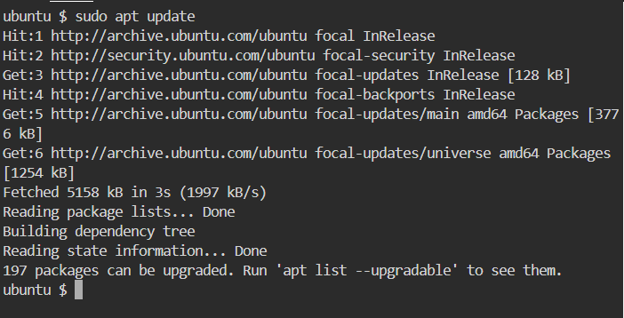
Update the Ubuntu Store System
DEVOPS INSIDER

Slide 3
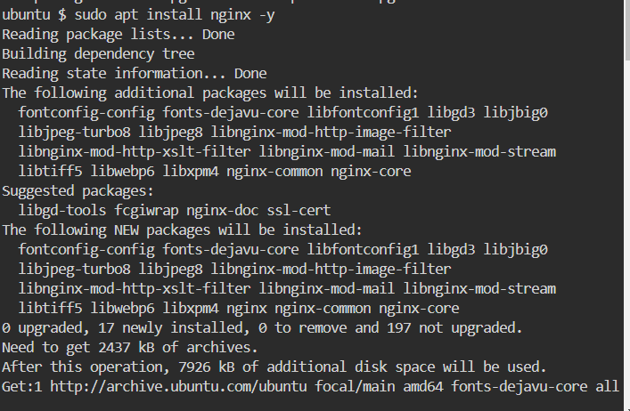
Install the Nginx Server from Apt Store
DEVOPS INSIDER

Slide 4
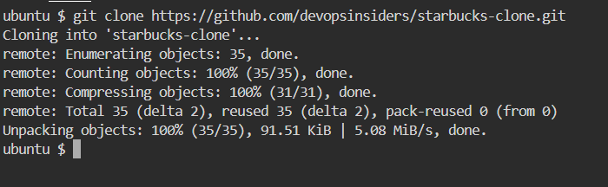
Clone the Starbucks Clone Repository:
DEVOPS INSIDER

Slide 5
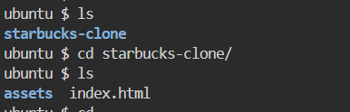

Copy Build Artifacts to Nginx Directory
DEVOPS INSIDER

Slide 6
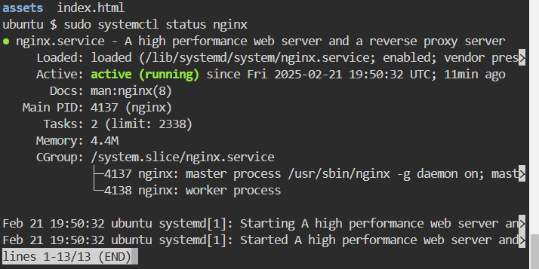
Check Nginx Status
DEVOPS INSIDER

Slide 7
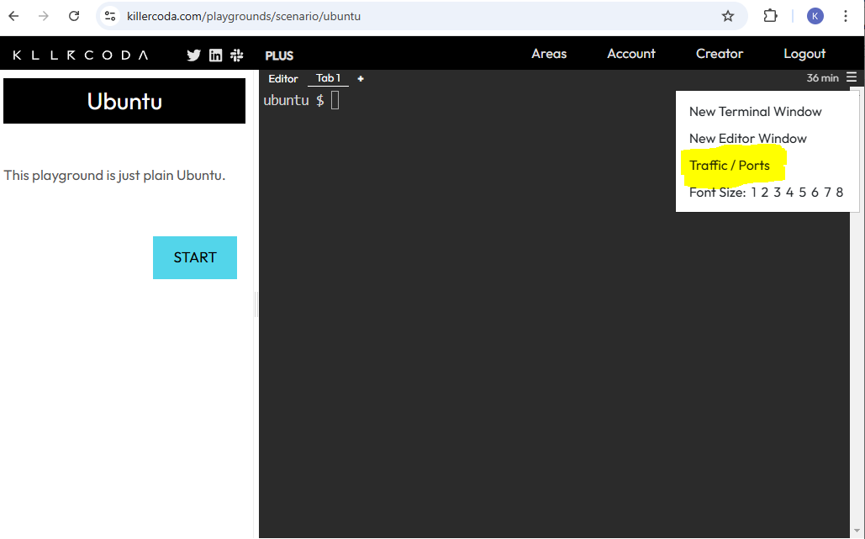
Use the "Expose" option in the Killer Coda interface to make port 80 accessible externally.
DEVOPS INSIDER

Slide 8
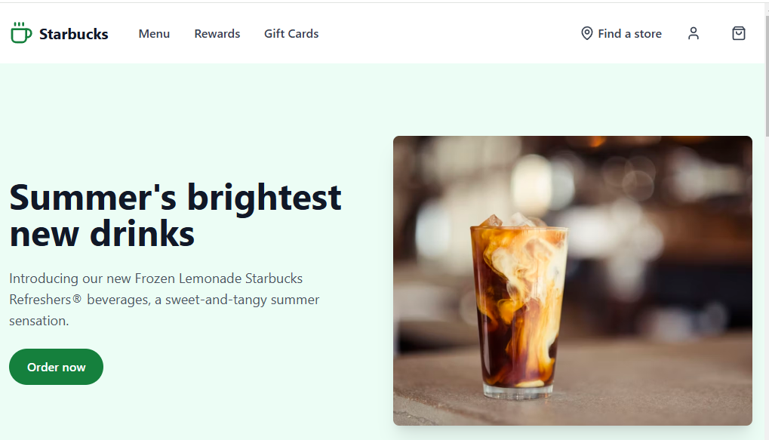
Access the Starbucks Clone Application After exposing port 80, access the provided URL or click the relevant button to view the Starbucks Clone application in your browser.
DEVOPS INSIDER

